Slide 1

Geant4 Simulation: PET
Andrea Baroni 10678096
Anna Emilia Candela 10705754
Petra Cipolla 10698521
Francesca Di Bella 10680769
Samuele Scortechini 10791607
Fabiana Zummo 10838719

Slide 2
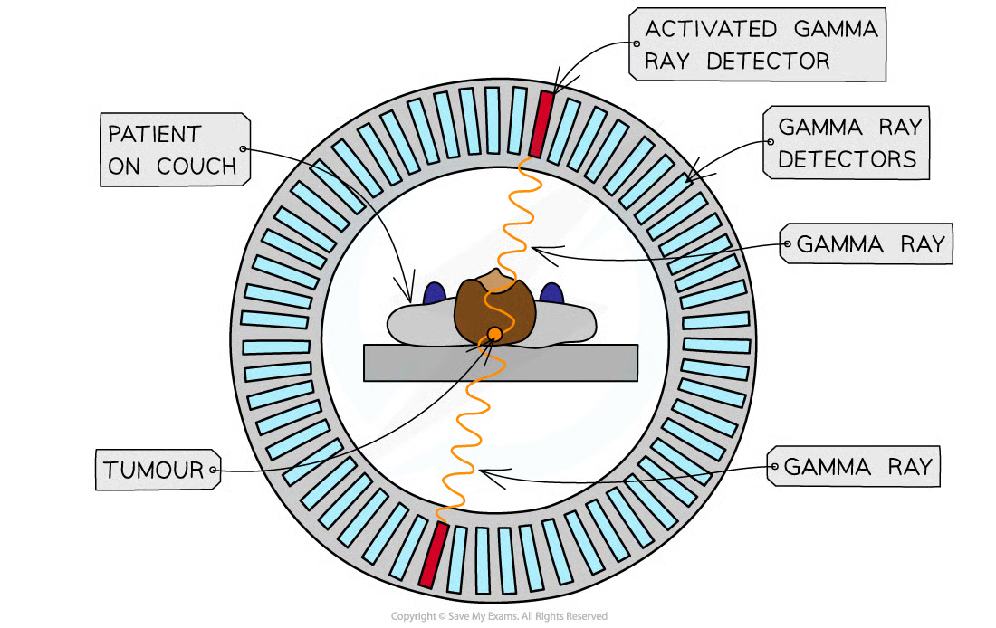
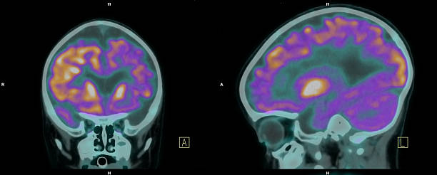
Introduction
Positron Emission Tomography (PET) is a biomedical imaging technique, which can provide functional information about metabolic activity
511 KeV
511 KeV

Slide 3
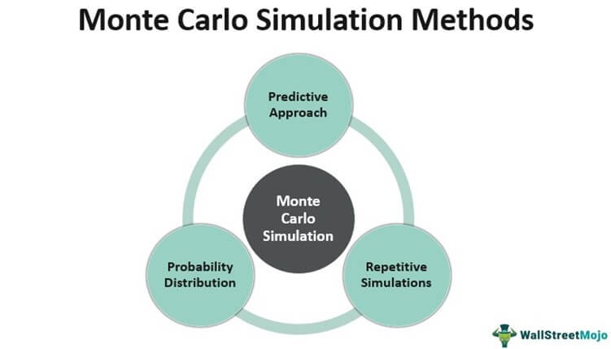


Geant4 and Monte Carlo Simulation
In Monte Carlo simulations of radiation transport, the behavior of radiation particles is simulated by tracking their interactions and movement through a medium or a system
Software:

Slide 4
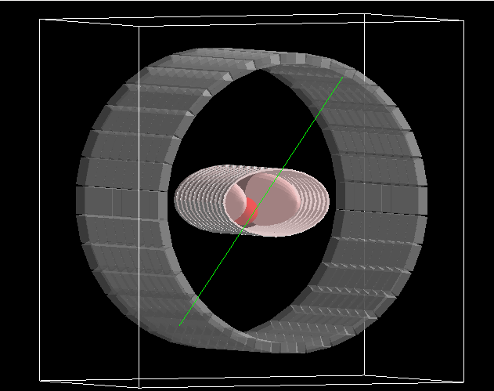
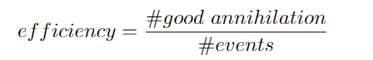
Good annihilation
Good annihilation
Two detected gamma rays at 511keV in opposite directions
Definition

Slide 5
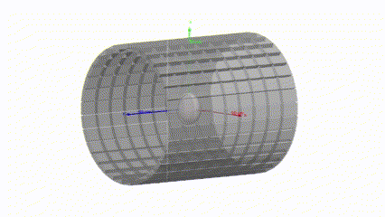
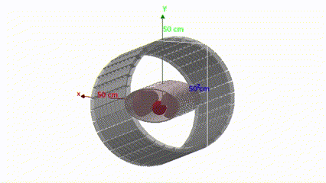
Patient Phantom
Head
Thorax
Brain and skull
Heart, lungs, rib cage and soft tissue

Slide 6

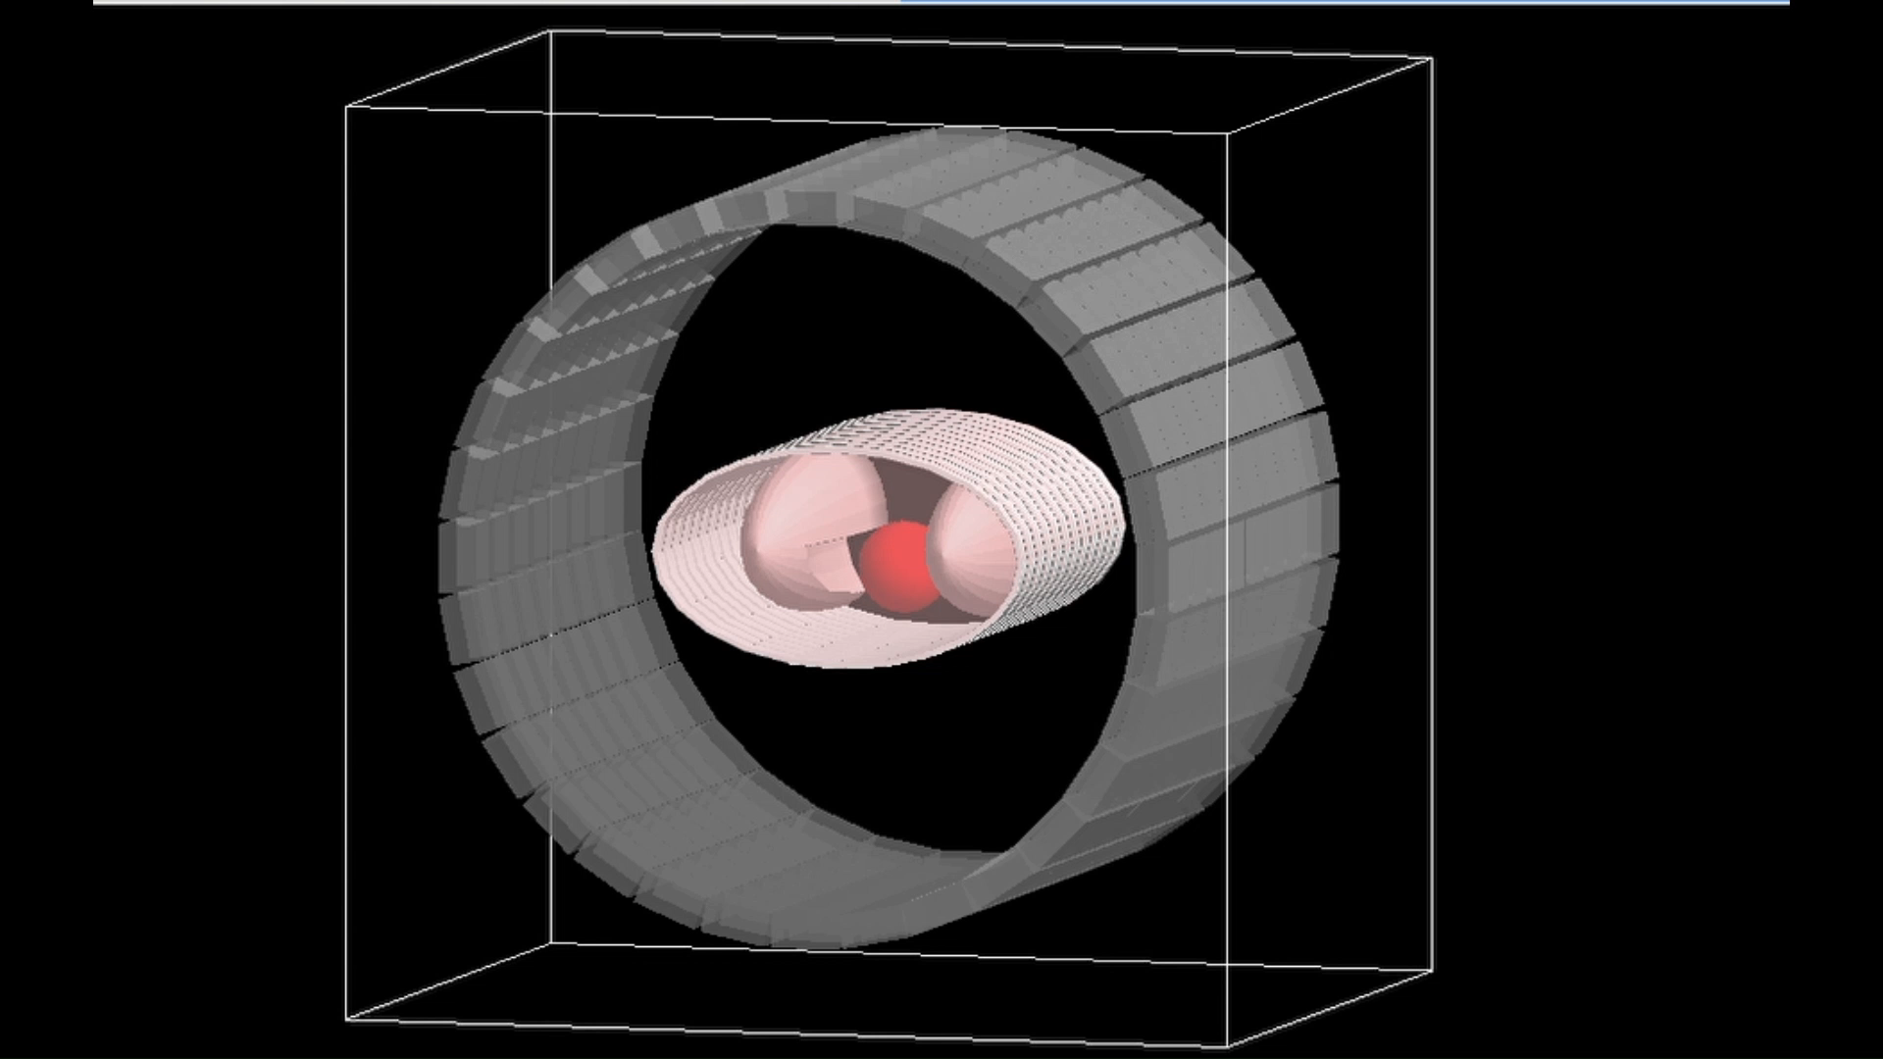
Simulations
Geant4 analyzes event by event
Next steps:
Materials
Analyze how efficiency changes by simulating with different detector materials: BGO, LSO, LYSO, LFS
Geometry
Change geometry of detectors: width of crystals, number of rings, number of crystals per rings
Dose
Evaluate dose absorption by simulating both head and thorax and changing position of the source

Slide 7
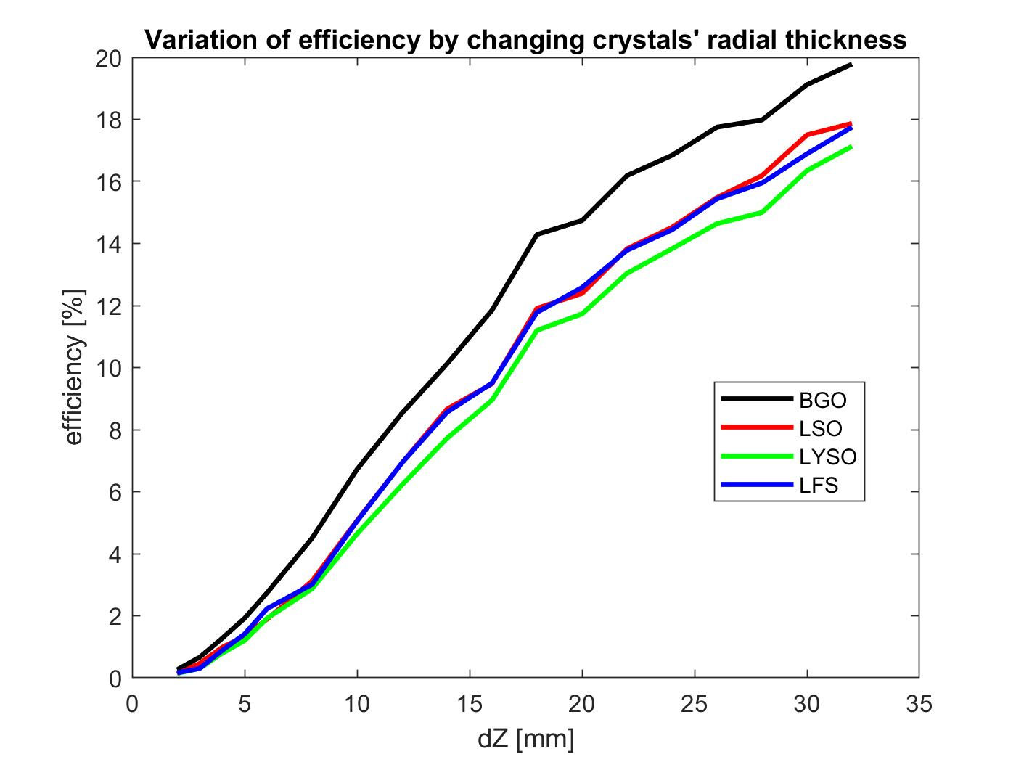
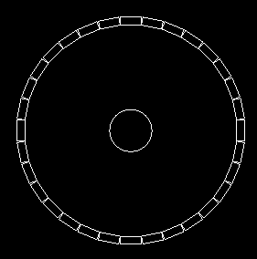
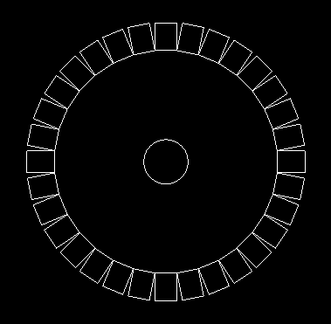
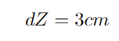
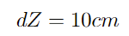
Detector: Crystal Width
Internal diameter = 80 cm
dZ = thickness
When the thickness of the crystals increases, the number of detected good annihilations proportionally increases
typical range of values

Slide 8
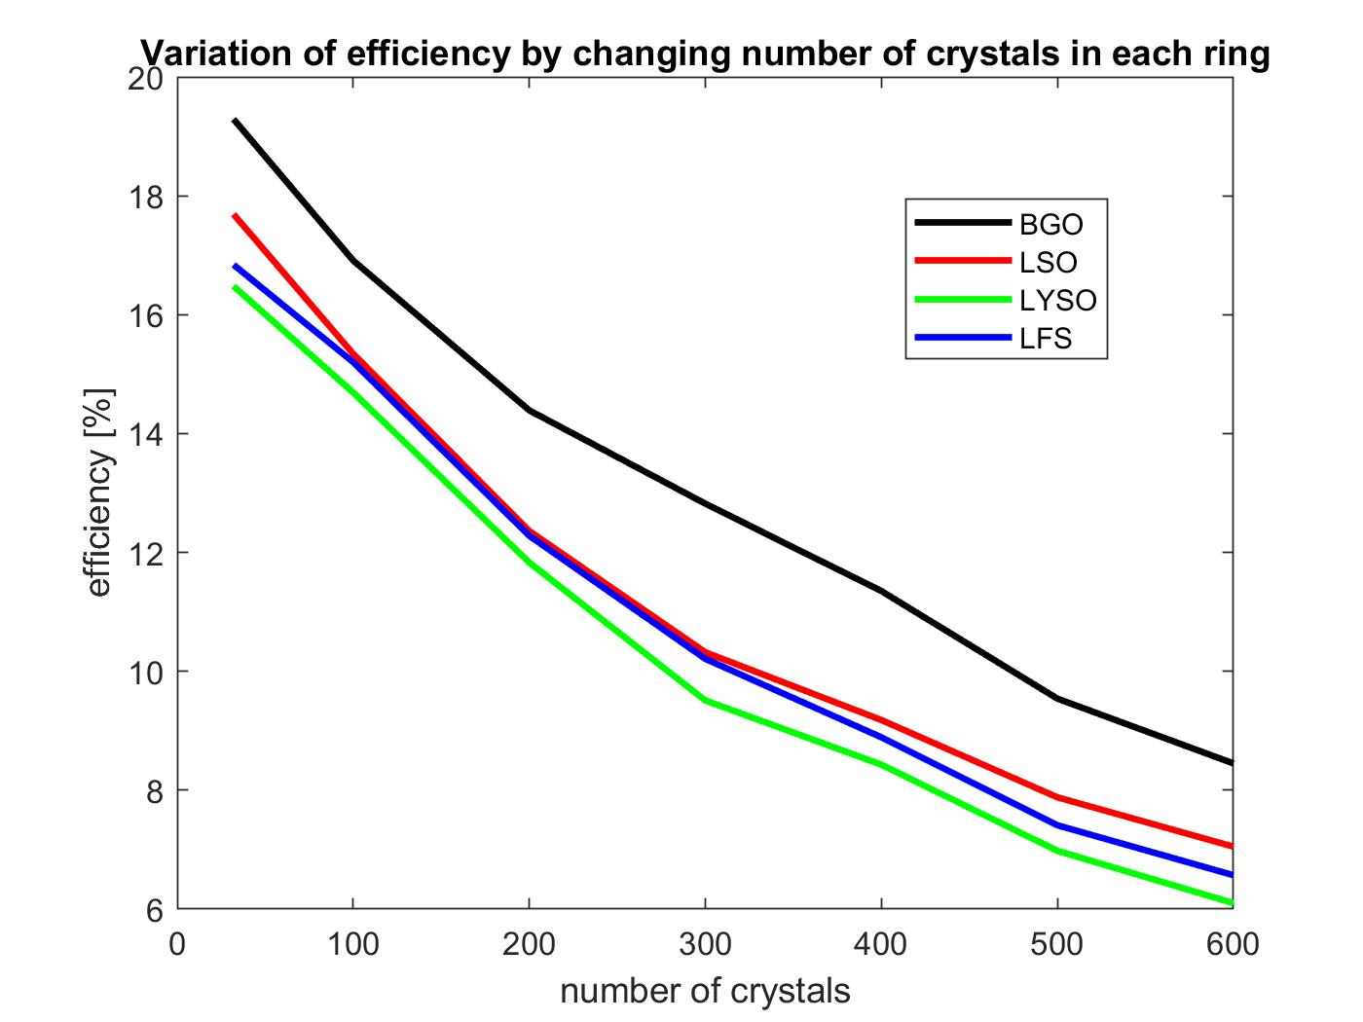
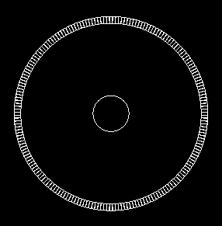
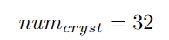
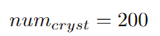

Detector: Number of Crystals per Ring
Internal diameter = 80 cm
typical value
When the number of crystals per ring increases, the detection efficiency decreases
However, there is a trade off between efficiency and spatial resolution

Slide 9
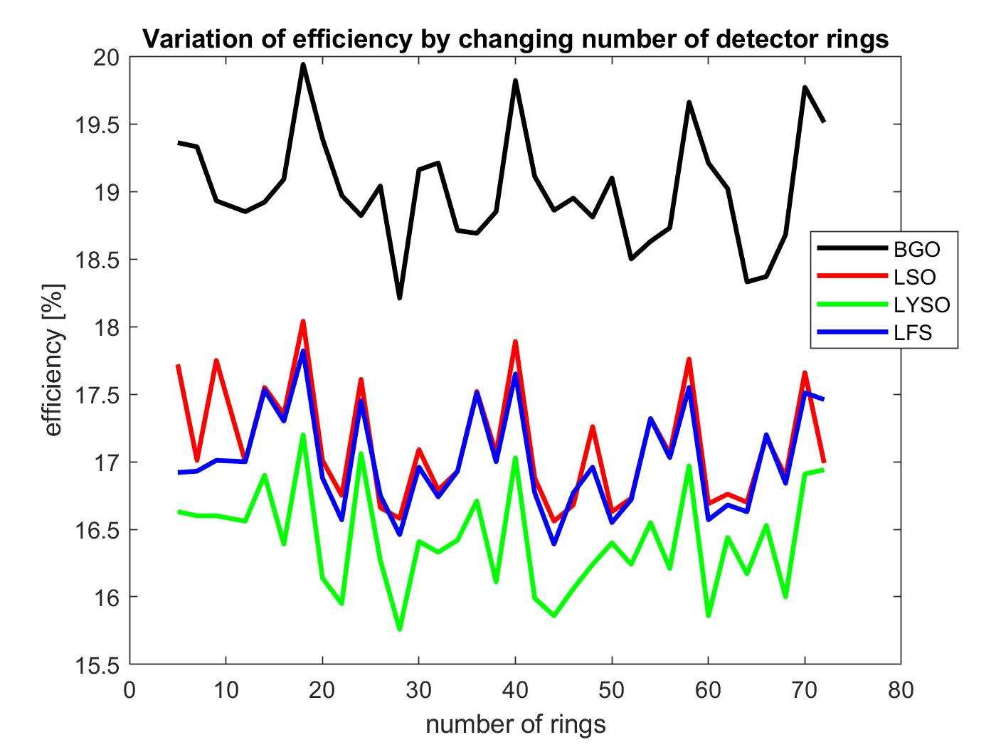
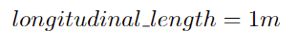
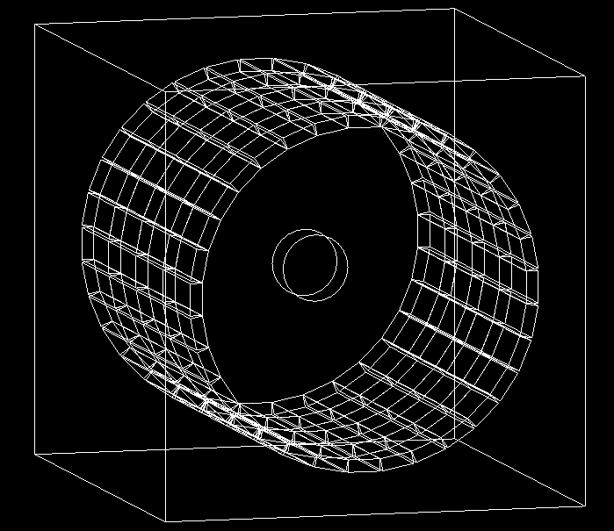
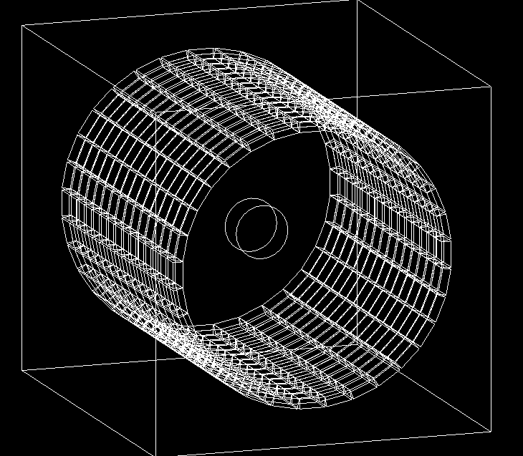

Detector: Number of Rings
typical value
1 m
1 m
Num. of rings = 8
Num. of rings = 15
When the number of rings increases (and total detector length is kept constant, thus decreasing crystals' length), the efficiency is not monotonic
Perhaps, these oscillations depend on adjustment of efficiency by changing two dimensions (length of crystals and number of rings)

Slide 10

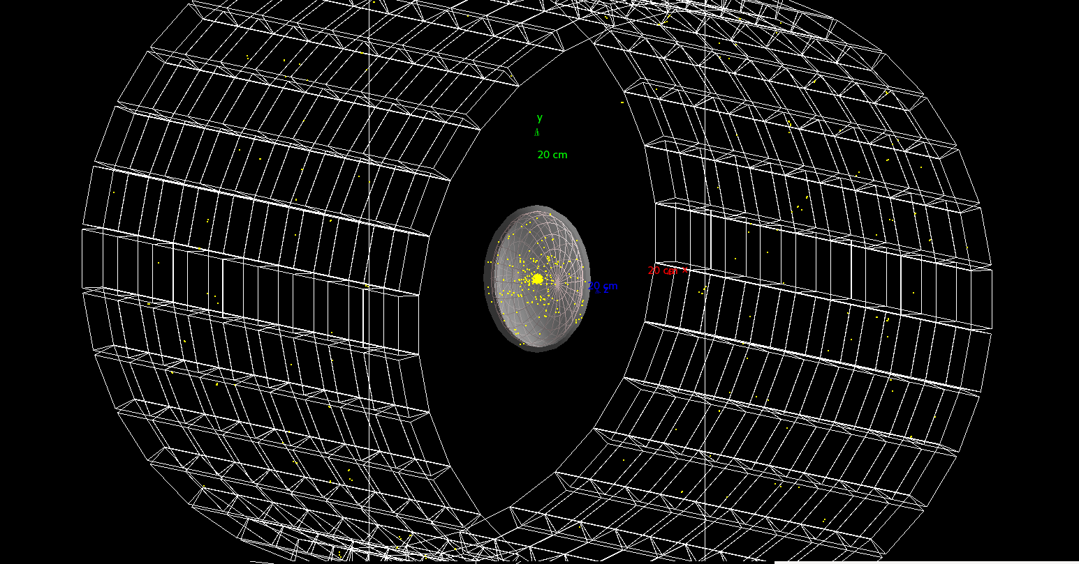
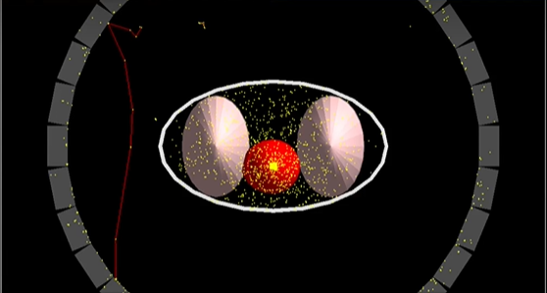
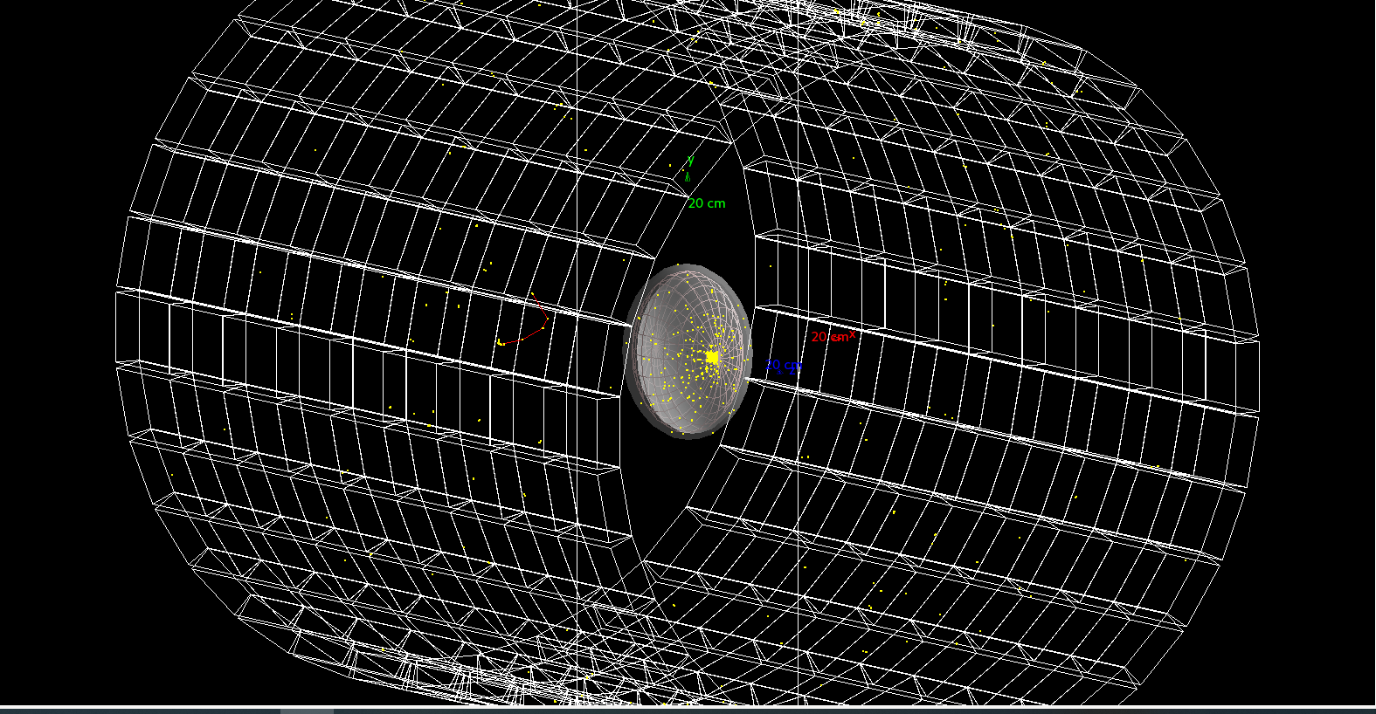
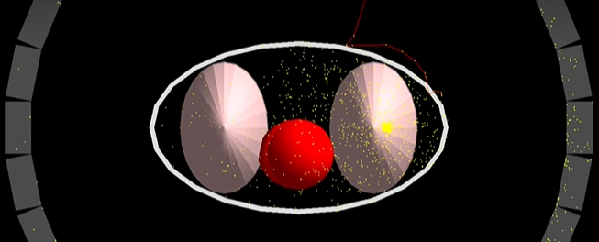

Source position
different sourse position -> different dose deposition
Thorax
Heart source
Head
Central source
Head
Peripheral source
Thorax
Left lung source

Slide 11
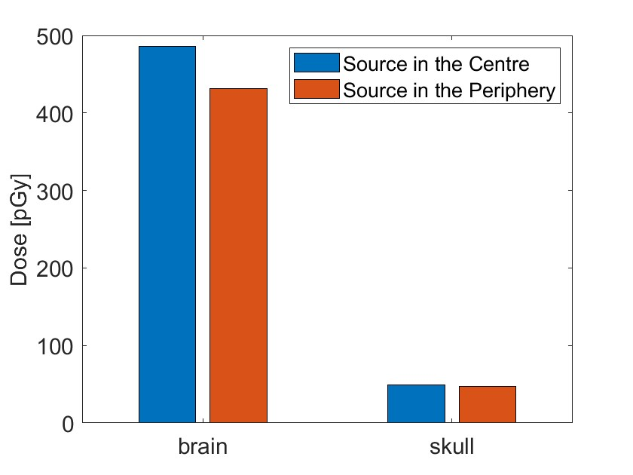
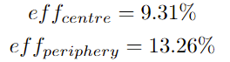
Dose: head
Head
Central source
Head
Peripheral source

Slide 12
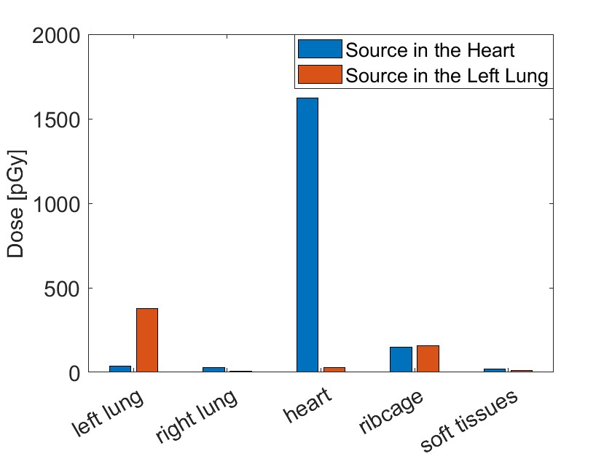
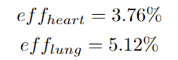
Dose: thorax
Heart source
Left lung source

Slide 13
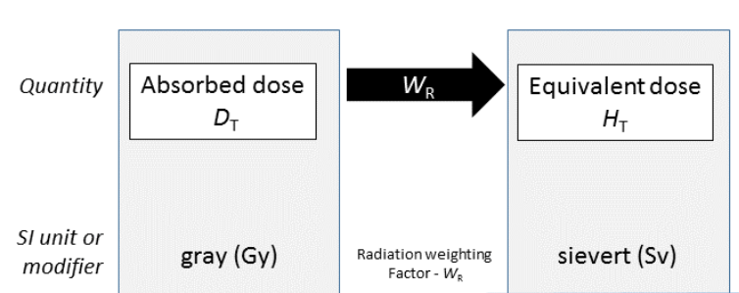

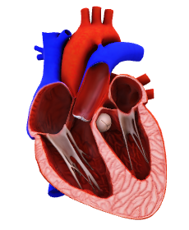
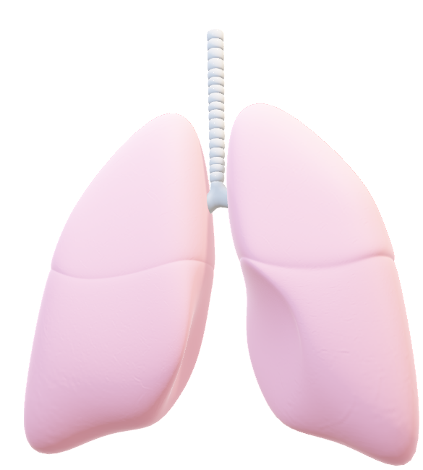
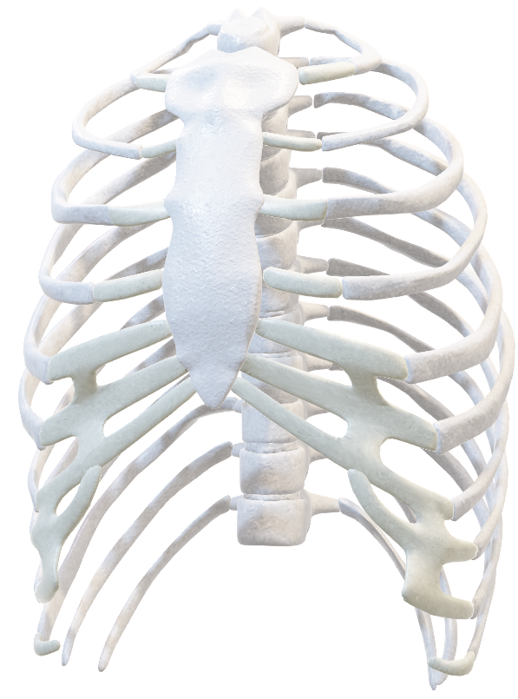

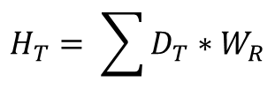
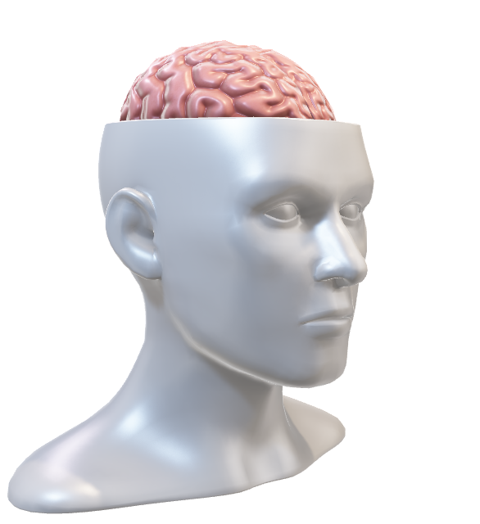

Equivalent Dose
By moving the source from the center to the periphery there is a decrease of 11% equivalent dose
$$H_{T}= \sum{D_{T}}∗W_{R}$$
W_{R} = 1 for gamma rays
By moving the source from the heart to the left lung there is a decrease of 68% equivalent dose
Since simulations are affected by approximation, here are reported qualitative analysis

Slide 14

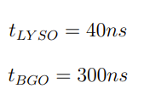

Conclusions
Limits of our simulation
We only consider the detectors but neither the photomultiplier tubes nor the image reconstruction
Our best simulation is with BGO; in contrast with reality due to the presence of other factors such as temporal resolution
Dose absorption
Influenced by the position of the source
Head: minimal variation because we are dealing with small geometries.
Thorax: higher variation.
Source in the lung: there could be the presence of air
Source in the heart: it is denser so absorbs more dose

Slide 15
Bibliography
Borasi, Giovanni, Federica Fioroni, Alberto Del Guerra, e Giovanni Lucignani. 2010. «PET Systems: The Value of Added Length». European Journal of Nuclear Medicine and Molecular Imaging 37 (9): 1629–32. https://doi.org/10.1007/s00259-010-1438-9.
Daube-Witherspoon, Margaret E., e Simon R. Cherry. 2021. «Scanner design considerations for long axial field-of-view PET systems». PET clinics 16 (1): 25–39. https://doi.org/10.1016/j.cpet.2020.09.003.
Ghabrial, Amir, Daniel Franklin, e Habib Zaidi. 2018. «A Monte Carlo Simulation Study of the Impact of Novel Scintillation Crystals on Performance Characteristics of PET Scanners». Physica Medica 50 (giugno): 37–45. https://doi.org/10.1016/j.ejmp.2018.05.010.
Grodzicka, M., M. Moszyński, T. Szczęśniak, A. Syntfeld-Każuch, Ł Świderski, A. F. Zerrouk, e J. Owczarczyk. 2011. «Characterization of LFS-3 scintillator in comparison with LSO». Nuclear Instruments and Methods in Physics Research Section A: Accelerators, Spectrometers, Detectors and Associated Equipment 652 (1): 226.
Jutila, Henri, Paul Greenlees, Tiina Torvela, e Maarit Muikku. 2023. «Technical Note: Simulation of Lung Counting Applications Using Geant4». Physica Medica 108 (aprile): 102573. https://doi.org/10.1016/j.ejmp.2023.102573.
Moses, William W. 2011. «Fundamental Limits of Spatial Resolution in PET». Nuclear instruments & methods in physics research. Section A, Accelerators, spectrometers, detectors and associated equipment 648 Supplement 1 (agosto): S236–40. https://doi.org/10.1016/j.nima.2010.11.092.
Purkait, Ruma. 2011. «Growth of Cranial Volume: An Anthropometric Study». Journal of Plastic, Reconstructive & Aesthetic Surgery 64 (5): e115–17. https://doi.org/10.1016/j.bjps.2011.01.005.
Turkington, Timothy G. 2001. «Introduction to PET Instrumentation». Journal of Nuclear Medicine Technology 29 (1): 4–11.
Vandenberghe, Stefaan, Pawel Moskal, e Joel S. Karp. 2020. «State of the Art in Total Body PET». EJNMMI Physics 7 (1): 35. https://doi.org/10.1186/s40658-020-00290-2.
Xie, Siwei, Xi Zhang, Yibin Zhang, Gaoyang Ying, Qiu Huang, Jianfeng Xu, e Qiyu Peng. 2020. «Evaluation of Various Scintillator Materials in Radiation Detector Design for Positron Emission Tomography (PET)». Crystals 10 (10): 869. https://doi.org/10.3390/cryst10100869.

Slide 16

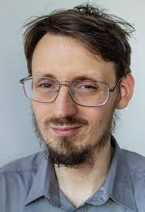
Thanks for your attention!

Slide 17
Future developments
In order to make a complete comparison among materials, other aspects may be considered (e.g. temporal resolution, image reconstruction)
Importance of balancing detector sensitivity with appropriate radiotracer dosage to obtain high-quality images without compromising patient safety

Slide 18
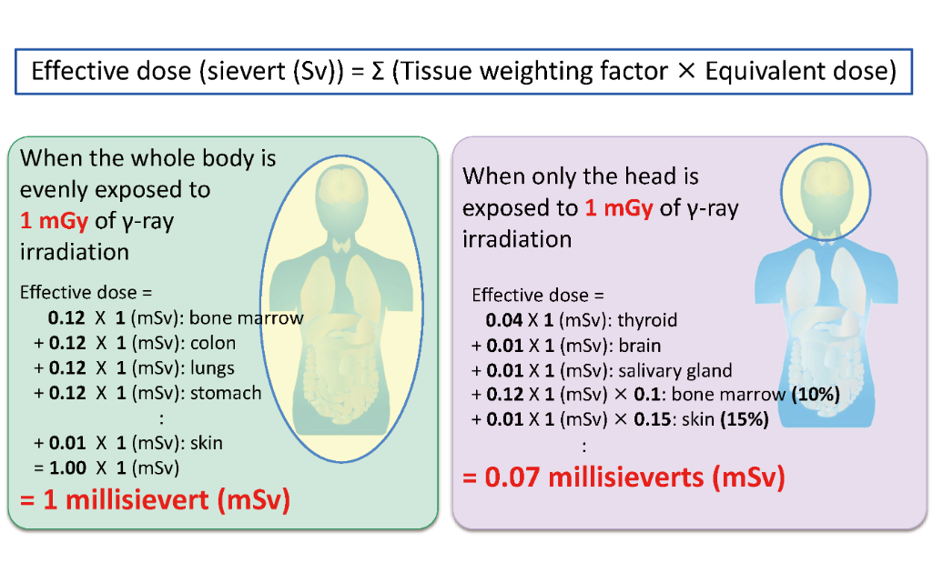
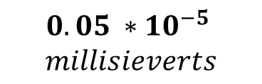
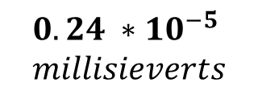
Equivalent dose: comparison
REAL
SIMULATION
maximum value
Whole Body
Head
$$0.24 ∗{10}^{−5}$$
$$millisieverts$$
$$0.05 ∗{10}^{−5}$$
$$millisieverts$$

